Slide 1
Subject: Multimedia Computing and Technology CHAPTER-3 Image and Graphics
By: Ramesh Basaula

Slide 2
3. Image and Graphics
3.1 Basic image graphics representation and formats
3.2 Image processing fundamentals Synthesis analysis and transformation.

Slide 3
Image
An image is a spatial representation of an object, a two-dimensional or three dimensional scene.
Spatial coordinates denoted with x, y on the x-axis and y-axis, respectively.
It can be real or virtual. A recorded image may be in a photo graphics, analog video signal or digital format.
In a computer vision, an image is usually a recorded image such as a video image, digital image or picture.
In computer graphics, an image is always a digital image.

Slide 4
Types of image
Real and virtual image
Analog and digital image
Raster and vector image

Slide 5
Real and virtual image
Real image:
These images are formed at the point where actually light converges.
It can be produced by convex mirrors.
Image is formed in the front side of mirror.
Example: image on theater screen.
Virtual image:
These images are formed at the point where light appears to have converges.
It can be produced by concave mirrors.
Image is formed in the back side of mirror.
Example: reflection of any object on plane mirror.

Slide 6
2. Analog and digital image
Analog image:
This image is denoted by sine wave.
It has continuous signal.
Examples: image formed by human eye
Digital image:
This image is denoted by square wave.
It has discrete signal.
Examples: computer image

Slide 7
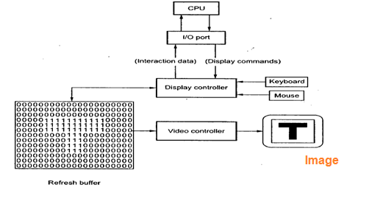
3. Raster and vector image(assignment)

Slide 8
Computer Graphics
Computer graphics are graphics created using computers and the representation of image data by a computer specifically with help from specialized graphic hardware and software.
Computer graphic development has had a significant impact on many types of media and have revolutionized animation, movies and the video game industry.
Graphics are visual images or designs on some surface, such as a wall, canvas, screen, paper, or stone to inform, illustrate, or entertain.
Dynamic in Graphics
Pictures can be dynamically varied by adjusting the animation speed, portion of the total scene in view, the amount of details shown etc.
Motion Dynamics: Objects are moved and enabled with respect to a stationary or also dynamic observer, e.g. flight simulator.
Update Dynamics: Objects being viewed are changed in shape, color, or other properties, e.g. deformation of an in-flight aeroplane structure.

Slide 9
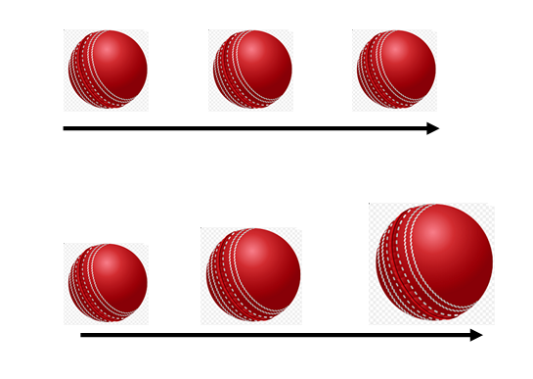
Example of Motion Dynamics:
Time
1 sec
2 sec
3 sec
Example of Update Dynamics:
Time
1 sec
2 sec
3 sec

Slide 10
Digital Image Representation
A digital image is an image composed of picture elements, also known as pixels.
Depending on whether the image resolution is fixed, it may be of vector or raster type.
When image(I) is a two-dimensional matrix then I(r,c) is the intensity value at position corresponding to row r and column c of the matrix.
The pixels values of intensity images are called Gray scale levels.
The intensity at each pixel is represented by an integer and is determined from the continuous image by averaging over a small neighbourhood around the pixel location.
If there are just two intensity values, for example, black and white, they are represented by the numbers 0 and 1, such images are called binary-valued images.
Digital pictures are often very large.

Slide 11
Image Format/ Image File Format
Assignment

Slide 12
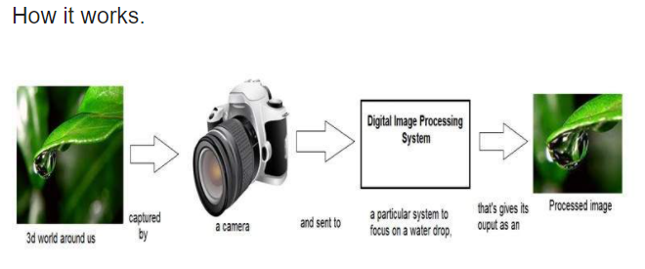
3.2 Image processing fundamentals Synthesis analysis and transformation
Digital Image Processing/Computer Image Processing:
Digital image processing is the use of a digital computer to process digital images through an algorithm.
It deals with manipulation of digital images through a digital computer.
?

Slide 13
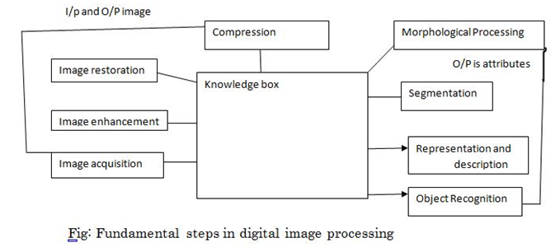
Fundamental step of digital image processing

Slide 14
1. Image acquisition:
It is the first process in the digital image processing. Generally image acquisition stage involves pre-processing such as scale.
2. Image Enhancement:
It is the simplest area of digital image processing.
The idea behind the enhancement technique is to bring out details that is hidden or not clearly seen or highlight the certain feature of the interest of the image.
E.g. Increase the contrast of an image.
3. Image Restoration:
Image restoration is the area that also deals with improving the appearance of the object (image).
It is objective in the sense that restoration technique tends to be based on mathematical or probabilistic model of image processing.
4. Image compression:
It deals with the technology or technique for reducing the storage required to save the image or the bandwidth required to transmit it.
Image compression is familiar to the most of the user of computer in the form of the file extension such as jpg extension.

Slide 15
5. Morphological process:
Morphological processing deals with tools for extracting components (attributes) that are useful in the representation and description of the shape.
E.g. shape detection, line detection, etc.
6. Segmentation:
It is the process of partitioning of an image into its component or object.
Segmentation is most difficult task in the digital image processing.
7. Representation and description (Labeling):
It almost always follow the output of segmentation state, which usually is a raw pixel data, consisting either boundary of the region or all the points in the region itself.
The decision that must be made is weather the data should be represented as boundary or complete region.
Description is also called feature selection.
8. Recognition (matching):
Recognition is the process that assigns a label in object based on its descriptions.
It is the process of classify the object according to the attributes extracted.

Slide 16
Image Synthesis
Process of creating new images from some form of image description.
Image synthesis is an integral part of all computer user interfaces and is essential for visualizing 2D, 3D and higher level dimensional objects.
Areas as diverse as education, science, engineering, medicine, advertising and entertainment all rely on graphics.
Some representative samples (benefits) of Image synthesis.
User Interface:
Personal computer today make extensive use of graphical user interface so that their operations to fulfill a task is limited to couple of point- and click operations, drag and drop operations to select menu-item, icon and object on the screen.
Office Automation and Electronic Publishing:
Electronic documents that contain text, tables, graphs and other forms of drawn or scanned graphics.
Simulation and Animation for scientific visualization and Entertainment.
Computer-produced animated movies and displays of time varying behaviour of real and simulated objects are becoming increasingly popular scientific and engineering visualization.

Slide 17
Image Analysis
Image Analysis is concerned with techniques for extracting descriptions from images.
Hence, image analysis techniques include computation of perceived brightness and color, partial or complete recovery of three-dimensional data in the scene, location of discontinuous corresponding to objects in the scene and characterization of the properties of uniform regions in the image.
Image analysis is important in many areas:
Aerial Surveillance photographs
Slow scan television images of the moon or planets gathered from space probes.
Television images taken from an industrial robot’s visual sensor.
X-ray images and computerized axial tomography (CAT) scans.
CAT: Pictures of structures within the body created by a computer that takes the data from multiple X-ray images and turns them in pictures. The CAT scan can reveal some soft-tissue and other structures that cannot be seen in conventional X-rays.
Sub-areas of image processing include:
Image enhancement
Pattern detection and recognition
Scene analysis and computer vision

Slide 18
Image Recognition
It is the method of acquiring, analyzing, and understanding images to produce numerical information.
In other words, image recognition is a computer’s way of doing what your eye does: see a picture and understand it.
Recognition an object in an image means knowing that there is agreement between the sensory projection and the observed image.

Slide 19
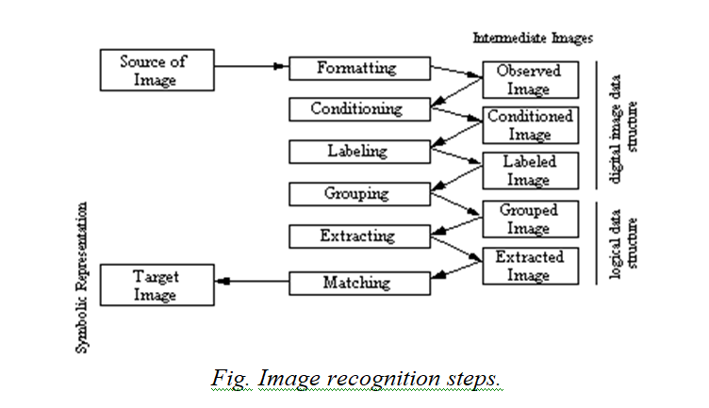

Slide 20
A recognition methodology must follow six steps:
Image formatting
Image formatting means capturing an image form a camera and bringing it into a digital form.
So, we have a digital representation of an image in the form of pixels.
2. Conditioning
Conditioning is based on the model that suggests the observed image is composed of an informative pattern, which is not of interests that typically add to multiply the informative pattern.
Estimates informative pattern on the basis of the observed image.
Thus conditioning remove noise, this can be assumed as random un-patterned variations affecting all measurement.
3. Labeling
Labeling is based on a model that suggests the informative pattern has structure as a spatial arrangement of events, each spatial event being a set of connected pixels.
Labeling determine in what kinds of spatial events each pixel participates.
Examples: edge detection and corner detection.

Slide 21
4. Grouping
The grouping operation identifies the events by collecting together or identifying maximum connected set of pixel participating in the same kind of event.
Determines the new set of entities and grouping entities of interest in a separate group.
So, the grouping operation links the edges.
Example: line-fitting
5. Extracting
The extracting operation computer for each group of pixel a list of properties.
Measures the topological spatial relation between two or more groups.
Example properties include the centroid area, number of holes in a region, orientation spatial moments, gray tone moments, circumscribing circle, inscribing circle, etc.
Extracting operation may also determine if two group touches are close or that one group is above the other.
6. Matching
After the completion of extracting operations, the events of the image are identified and measured, but they have meaning.
Determines the interpretation of some related set of image events recognized previously with the extracting group.
The matching operation determine the interpretation of some related set of image events by associating these events with some given 3D object or 2D shape.
Example: template matching

Slide 22
Image Transmission
Image transmission takes into account transmission of digital images through computer networks.
There are several requirements on the networks when images are transmitted, which are:
The network must accommodate busty data transport because image transmission in busty.
Image transmission requires reliable transport.
Time dependence is not a dominant characteristic of the image in contrast to audio/ video transmission.
Images size depends on the image representation format used for transmission. There are several possibilities.

Slide 23
1. Raw image data transmission:
In this case, image is generated through a digitizer and transmitted in its digital format.
The size can be computed in the following manner:
size=spatial-resolution x pixel-quantization
if image resolution=640x480 pixels
pixel quantization=8 bits per pixel
Transmission size=307200 bytes
2. Compressed Image data transmission:
In this case, the image is generated through a video digitizer and compressed before transmission.
Methods such as JPEG or MPEG are used to downsize (compress) the image.
The reduction of image size depends on the compression method and compression rate.
3. Symbolic image data representation:
In this case, the image is represented through symbolic data representation as image primitives (example, 2D or 3D geometric representation), attributes and other control information.
This image representation method is used in computer graphics.

